Slide 1


School of Engineering Technology and Applied Science
The Machine Learning Process
using a decision tree model
Part 01
Reza Dibaj
Notes:
Six lines of code is all it takes to write your first Machine Learning program.

Slide 2
Contents
Open Source Libraries What is Machine Learning? Difference between apple and orang
Hands-on
Supervised Learning Recipe
Collect Training Data
Train Classifier
Make Predictions
Important Concepts

Slide 3
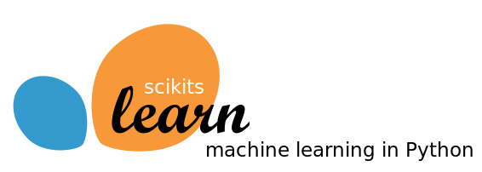

Open Source Libraries
scikit-learn
Click here for more info
TensorFlow
Click here for more info

Slide 4
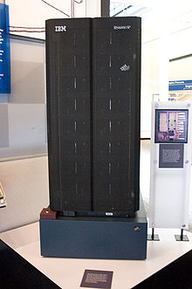
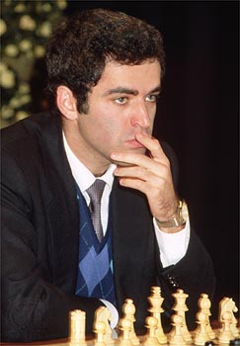
What is Machine Learning?
Subfield of Artificial Intelligence (AI)
Early AI programs typically exceled just one specific task
e.g. Deep Blue (chess computer)
VS
IBM Deep Blue
Garry Kasparov 1997

Slide 5
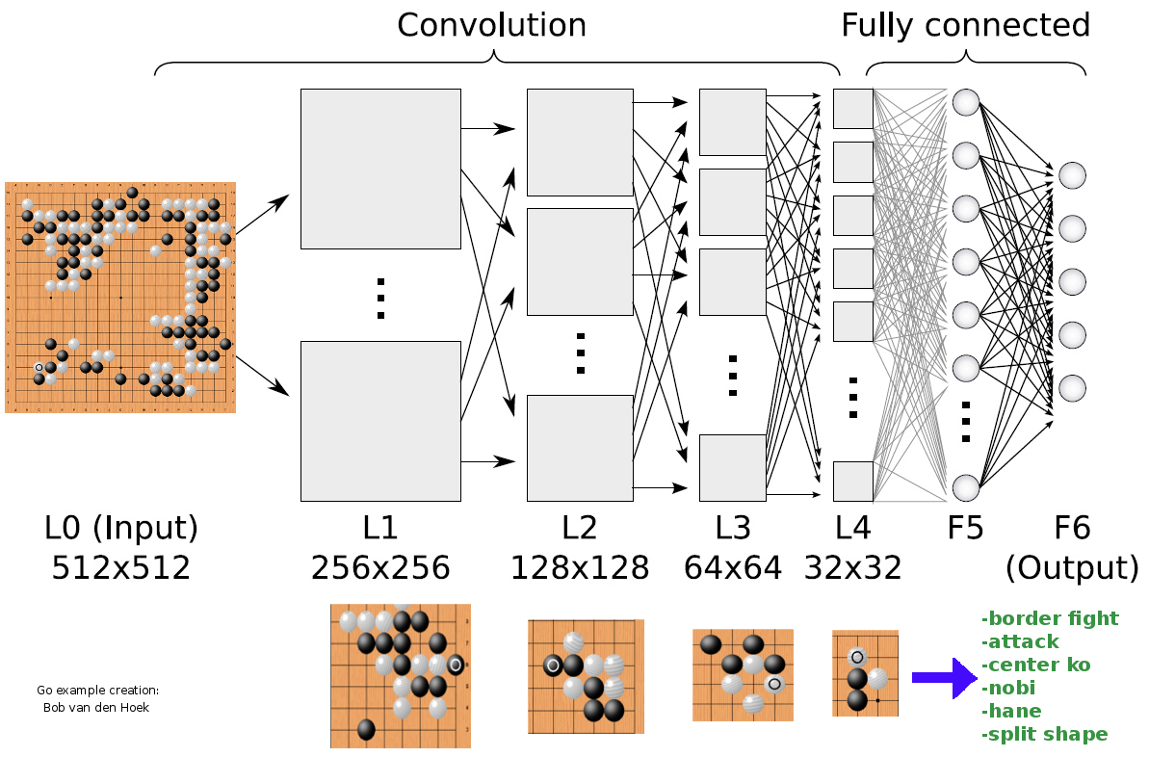
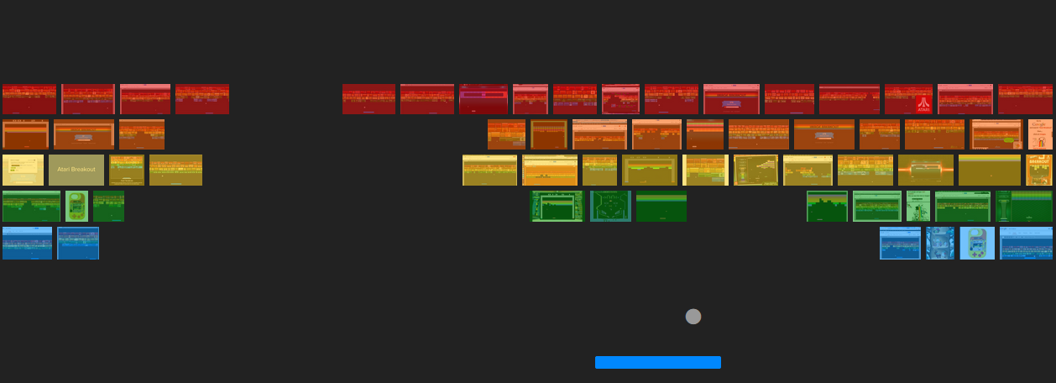

What is Machine Learning?
We want to write one program that can solve many problems without needing to be re-written

Slide 6
What is Machine Learning?
It is study of algorithms that learn from examples and experience, instead of relying on hard-coded rules.

Slide 7
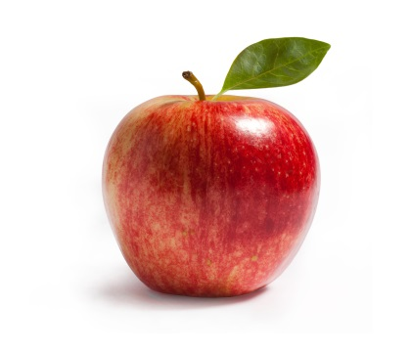

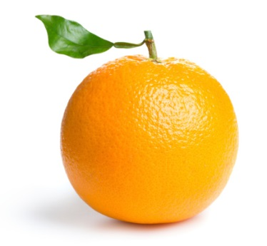
Difference between apple and orang
Write a program to take an image file as input, does some analyses, and output the type of fruit:
“Apple”
“Orange”

Slide 8
Difference between apple and orang
Write a program to take an image file as input, does some analyses, and output the type of fruit:
Counting the number of orange pixels and green pixels
Calculate the ratio

Slide 9
Difference between apple and orang
Write a program to take an image file as input, does some analyses, and output the type of fruit:
def detect_colors(image):
# lots of code
def detect_edges(image):
# lots of code
def analyse_shapes(image):
# lots of code
def guess_texture(image):
# lots of code
def define_fruit(image):
# lots of code
def handle_probability(image):
# lots of code

Slide 10
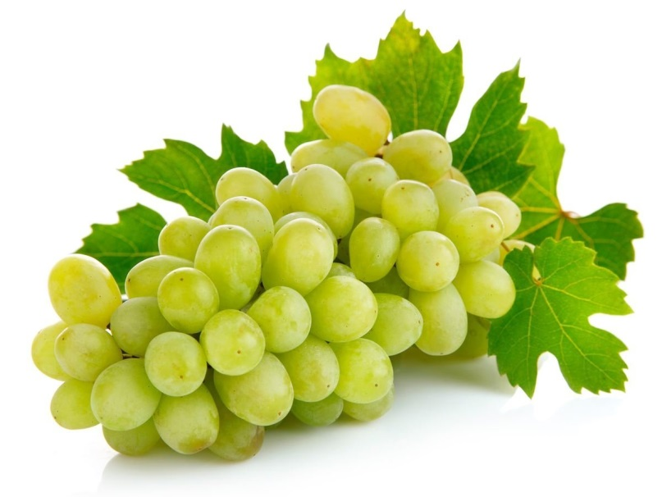
Difference between apple and orang
If we dive deeper into the problem, we will discover that the real world is more messy and the rules that we have defined will start to break.
?
?

Slide 11

Difference between apple and orang
Machine Learning is all about the algorithms that can define these rules for us.
For that we are going to train classifier.
Let’s consider classifier as a function that takes some data as input and assigns label to it as output.
“Spam”
“Apple”
Notes:
Clearly we need something better. To solve this, we need an algorithm that can figure out the rules for us, so we do not have to write them by hand.
And for that we are going to train a classifier. For now, you can think of a classifier as a function. It takes some data as input and assign a label to it as output.

Slide 12
Difference between apple and orang
The technique to write the classifier automatically is called Supervised Learning.
It begins with examples you want to solve by finding patterns in these examples.

Slide 13
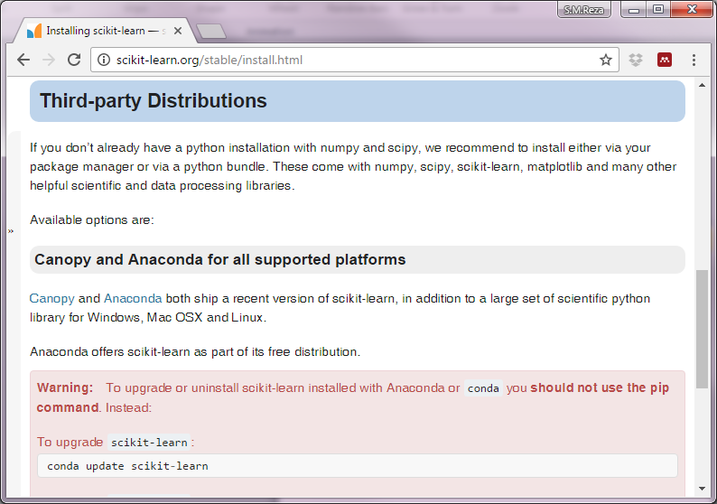
Hands on
We need to download and install scikit-learn:
Go to scikit-learn.org→ Installation tab
The easiest way to get all dependencies set up and works well cross platform.

Slide 14
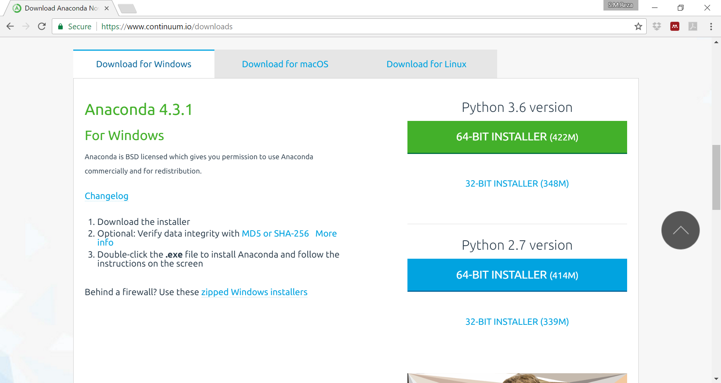
Hands on
Choose the appropriate version:

Slide 15
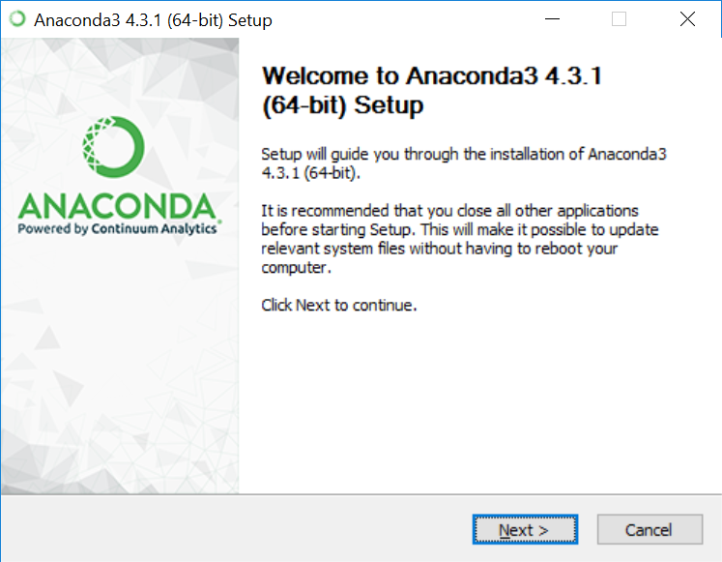
Hands on
Start installing:

Slide 16
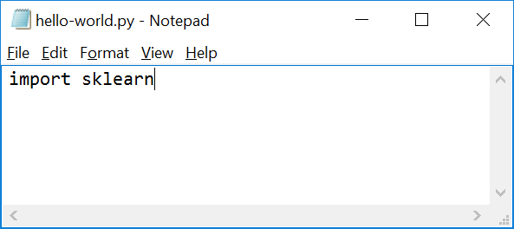
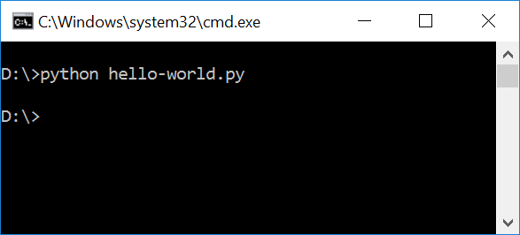
Hands on
Now create a file, named hello-world as follows:
And run the following command on Windows Command line:
Notes:
Hello-world.py
import sklearn
Command line:
python hello-world.py

Slide 17
Supervised Learning Recipe
Collect Training Data
Training Classifier
Make Predictions

Slide 18
Supervised Learning Recipe
Collect Training Data
Training Classifier
Make Predictions

Slide 19
Supervised Learning Recipe
Training Data
The more data we have, the better classifier we can make.
Features
Weight | Texture | Label
150g | Bumpy | Orange
170g | Bumpy | Orange
140g | Smooth | Apple
130g | Smooth | Apple
… | … | …
Examples
Notes:
Imagine we head out to an orchard.

Slide 20
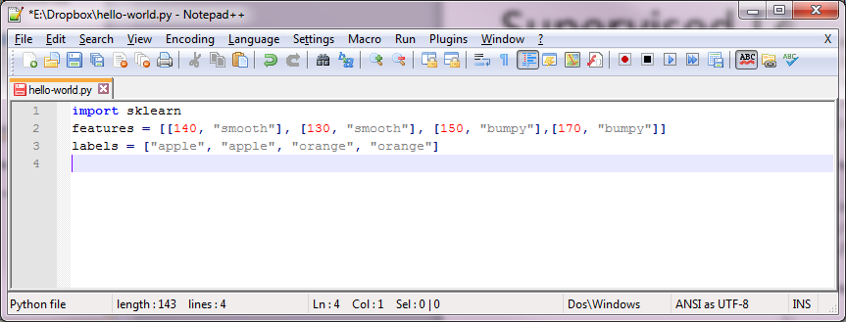
Supervised Learning Recipe
Training Data
Let’s get back to our “hello-world.py” file:
Input
Output
Notes:
import sklearn
features = [[140, "smooth"], [130, "smooth"], [150, "bumpy"],[170, "bumpy"]]
labels = ["apple", "apple", "orange", "orange"]

Slide 21
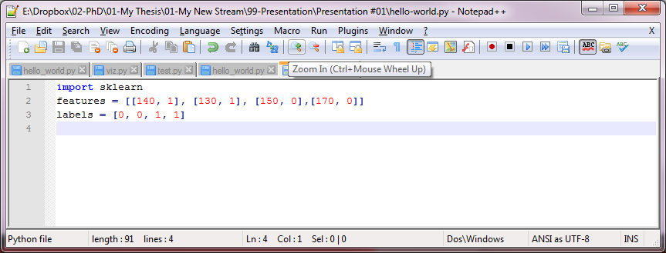
Supervised Learning Recipe
Training Data
Let’s replace features and labels with integer values.
Input
Output
Notes:
import sklearn
features = [[140, 1], [130, 1], [150, 0],[170, 0]]
labels = [0, 0, 1, 1]

Slide 22
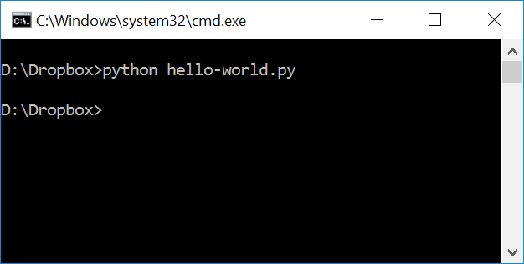
Supervised Learning Recipe
Training Data
We should run hello-world.py to see if we get no error:

Slide 23
Supervised Learning Recipe
Training Classifier
We use Decision Tree as our classifier and let’s assume it as a box of rules for now:
Collect Training Data
Training Classifier
Make Predictions

Slide 24
Supervised Learning Recipe
Training Classifier
We use Decision Tree as our classifier and let’s assume it as a box of rules for now:
Weight > 150g?
Yes
No
Texture = bumpy?
Yes
No
Orange
Apple

Slide 25
Supervised Learning Recipe
Training Classifier
We have different classifiers, and decision tree is just one of them:
160g Bumpy
“Orange”

Slide 26
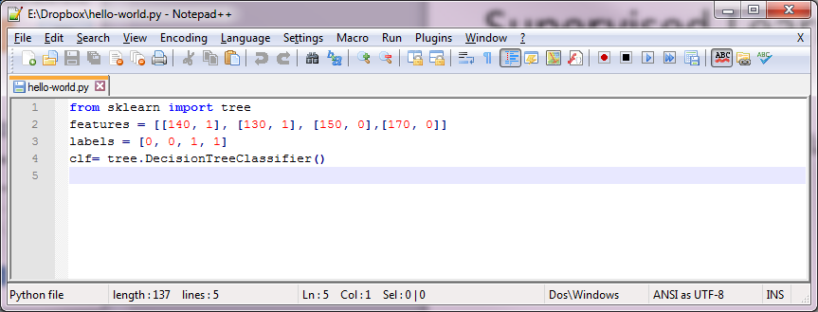
Supervised Learning Recipe
Training Classifier
At this point we define a classifier which is a box of rules. It does not know anything about “apple” and “orange” yet. To train it we need learning algorithm.
Notes:
from sklearn import tree
features = [[140, 1], [130, 1], [150, 0],[170, 0]]
labels = [0, 0, 1, 1]
clf= tree.DecisionTreeClassifier()

Slide 27


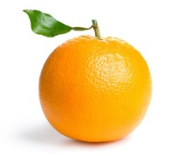
Supervised Learning Recipe
Training Classifier
If we consider a classifier as a box of rules, then we can assume a learning algorithm as the procedure that creates those rules. It does that by finding pattern in our training data:
For example: in our dataset, the heavier fruit is more likely to be an orange.

Slide 28
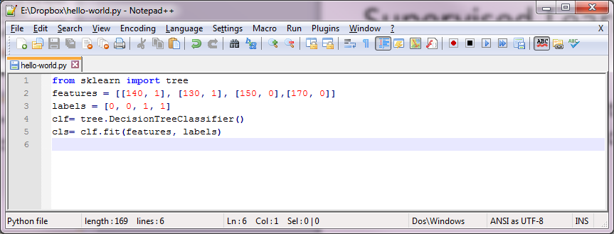
Supervised Learning Recipe
Training Classifier
In scikit the training algorithm is included in the classifier object and is called fit, which is actually nothing but finding pattern in data.
Notes:
Important: We can think of fit as find patterns in data.
We will get into details of how this happens under the hood in a future presentation.
from sklearn import tree
features = [[140, 1], [130, 1], [150, 0],[170, 0]]
labels = [0, 0, 1, 1]
clf= tree.DecisionTreeClassifier()
clf= clf.fit(features, labels)

Slide 29
Supervised Learning Recipe
Make Predictions
Collect Training Data
Training Classifier
Make Predictions

Slide 30
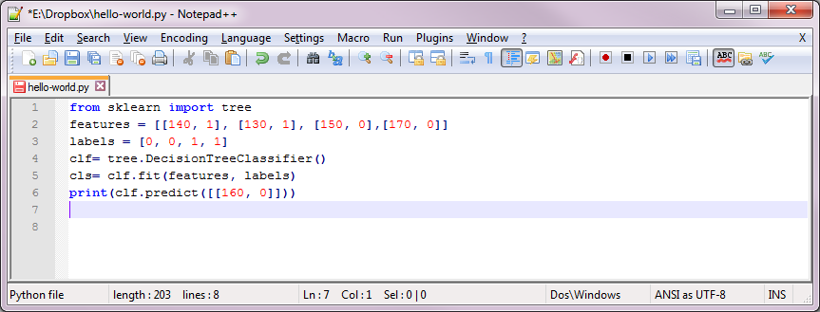
Supervised Learning Recipe
Make Predictions
Now its time to make prediction. So let’s take it for a spin and use it to classify a new fruit. What is your guess in this example?
Notes:
from sklearn import tree
features = [[140, 1], [130, 1], [150, 0],[170, 0]]
labels = [0, 0, 1, 1]
clf= tree.DecisionTreeClassifier()
clf= clf.fit(features, labels)
print(clf.predict([[160, 0]]))

Slide 31
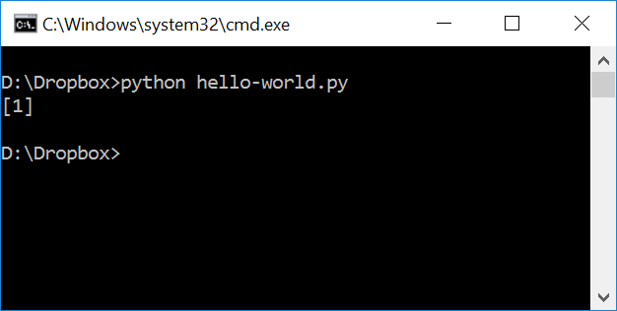
Supervised Learning Recipe
Make Predictions
Now its time to make prediction. So let’s take it for a spin and use it to classify a new fruit. What is your guess in this example?
That is true, as it is bumpy and heavier, it should be orange or 1.

Slide 32
Supervised Learning Recipe
Using the same program for a new problem
The more data we have, the better classifier we can make.
Horsepower | Seat | Label
300 | 2 | sport-car
450 | 2 | sport-car
200 | 8 | minivan
150 | 9 | minivan
… | … | …
Notes:
This makes this approach far more reusable than writing new rules for each problem.

Slide 33




Supervised Learning Recipe
We can create a new classifier for a new problem, just by changing the training data.
This approach is far more reusable than writing new rules for each problem.
Question:
Could we use images instead of variables?
Image | Label
 | Orange
 | Orange
 | Apple
 | Apple

Slide 34
Important Concepts
How does this work in the real world?
How much training data do we need?
How is the tree created?
What makes a good feature?
Notes:
The neat thing is that programming with Machine Learning is not hard.

Slide 35
Thank you

